Slide 1
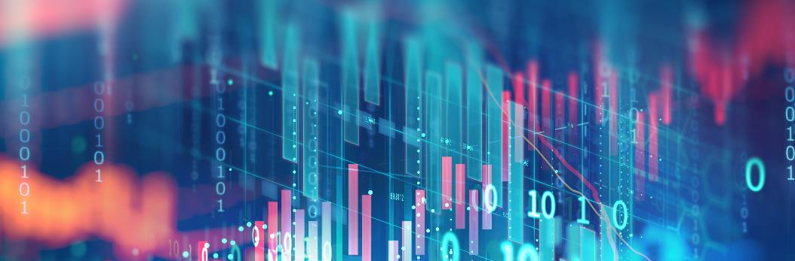

Smart Education
Monitoring System for classroom session in skill training program
DAKSH
YUG BENIWAL
YASH SHARMA
INVEST IN YOUR FUTURE

Slide 2
PROBLEM STATEMENT & SOLUTION
Monitoring System for classroom session in skill training program
In skill training programs, many students learn important job skills in classrooms. But sometimes, the quality of training is not good enough. It can be hard to know if teachers are teaching well or if students are really paying attention and learning.
Right now, there is no easy way to check how good the training is during the classes. We want a system that can look at pictures or videos from the classroom and understand what is happening - like if students are actively doing practical work, listening carefully, or just distracted.
Activity recognition: Use motion to detect interactions like:
RAISING HANDS
SLEEPING
LOOKING FORWARD
This solution leverages existing computer vision techniques, while incorporating curriculum mapping from educational frameworks, enabling proactive quality control in skill development programs. The system prioritizes detectability of genuine engagement patterns over superficial metrics, using multi-layered validation to ensure actionable insights.

Slide 3
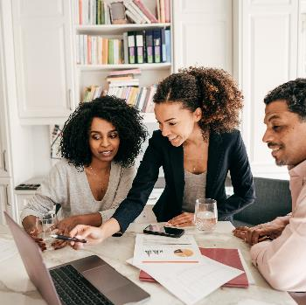

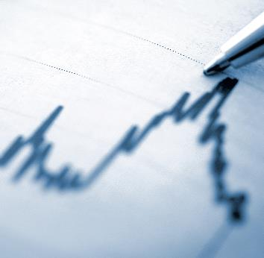
Potential Application
Our vision
"Revolutionize skill training with AI-powered classroom monitoring to guarantee quality, compliance, and employability through real-time insights."
Vocal Training sessions
Corporate Training Programs
Government Initiatives
We are here to help you develop successful strategies for today’s education for a secure tomorrow.

Slide 4
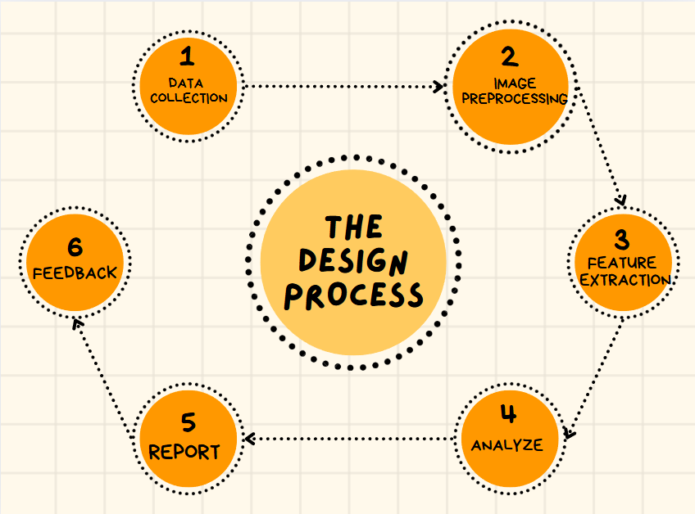
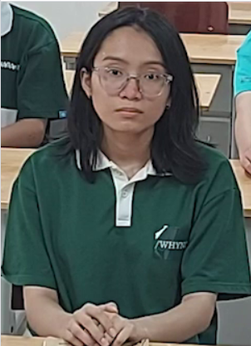
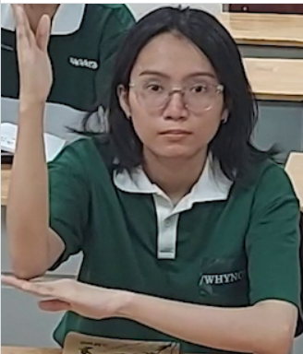
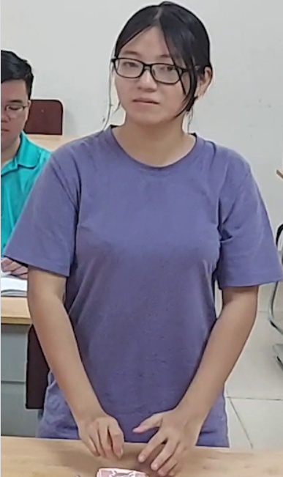

We collect the images
In this we prepare the raw data for further analysis such as by removing noise & clean the images which make them easier for algos. , to extract patterns and features.
This step used to standardize the image for ML model optimization . This step can be done by UPSCALING , DOWNSCALING .
3
CNN
In this step we remove variation such as color variation , brightness variation caused by conditions such as low light condition, etc..
In this we prepare our model by training by labels or features

Slide 5

DATA COLLECTION
DATASET COLLECTED FROM OPEN SOURCE
WITH CLASSES SUCH AS SLEEP, RAISE HAND ,ETC.
PREPROCESSING AND SPLITTING OF DATA
We collect the images
In this we prepare the raw data for further analysis such as by removing noise & clean the images which make them easier for algos. , to extract patterns and features.
This step used to standardize the image for ML model optimization . This step can be done by UPSCALING , DOWNSCALING .
In this step we remove variation such as color variation , brightness variation caused by conditions such as low light condition, etc..
In this we prepare our model by training by labels or features

Slide 6
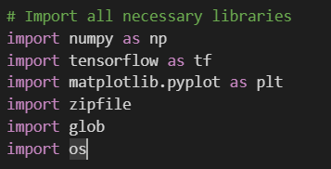
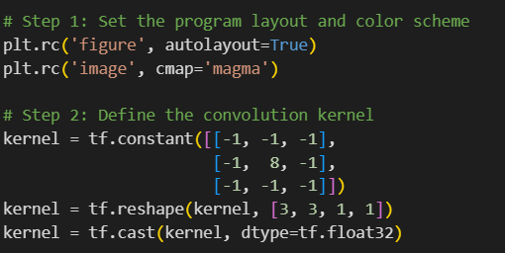
First, we import all libraries which required in image preprocessing
Step 1 is setting the program and color scheme this step help us in making our design appealing by choosing required colors for components.
##rc stands for run time configuration
Step 2 is defining the convolutional kernel
This step is used to preprocess the image it is a matrix representation of image used for edge detection
## lapless kernel or filter which is use for smooth edges detection

Slide 7
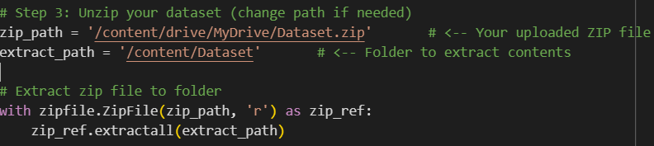
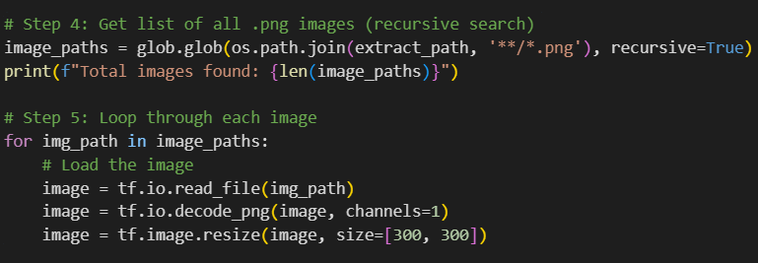
Loading the dataset and unzip it
Find all images/files having extension .png
Purpose of loop is to process all images/files that found in above step.

Slide 8
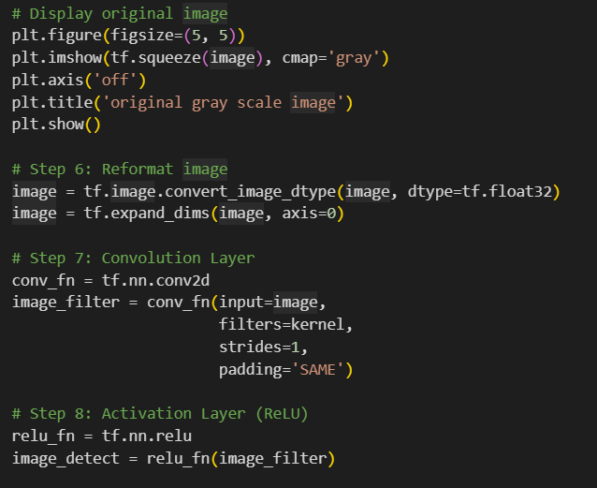
This steps show the grey-scale image before any NN processing
Reformatting we convert the pixel values from integer to floating values bcz its is standard format for NN inputs
Convolution layer
It help in detection of the edges, textures and patters of the image
We apply activation layer which is ReLU function as we have to remove all the negative values this function makes all the negative value 0 .

Slide 9
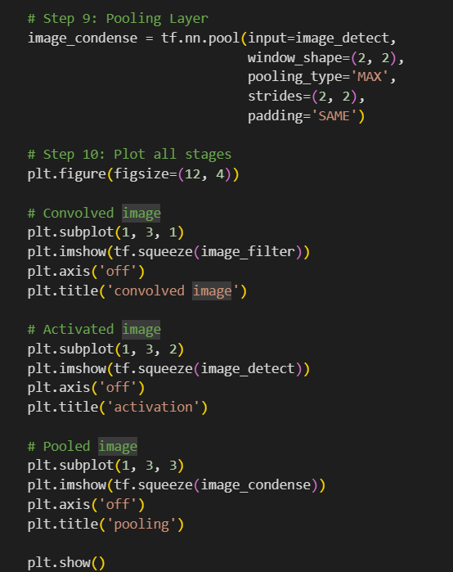
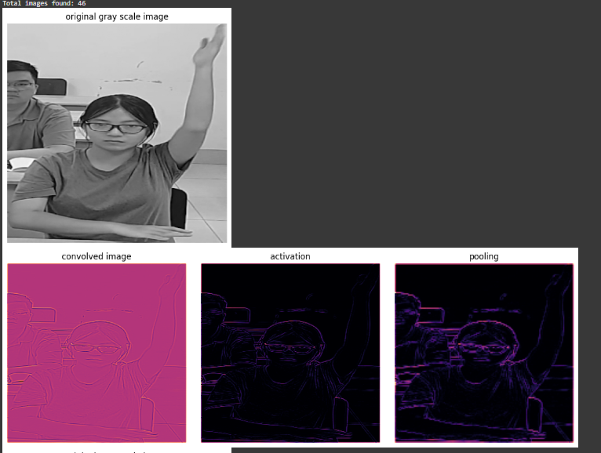
We apply a pooling layer
To retain the feature in each region
Which help in avoiding the overfitting
Final step is to see the changes in each steps and compare by plotting .
Result after plotting

Slide 10
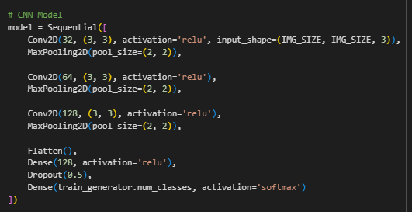
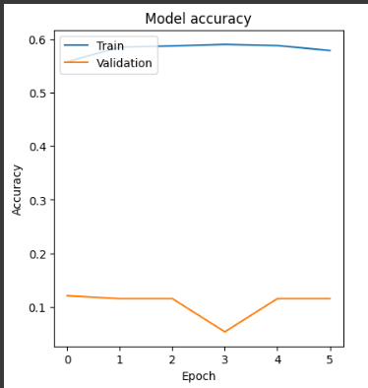
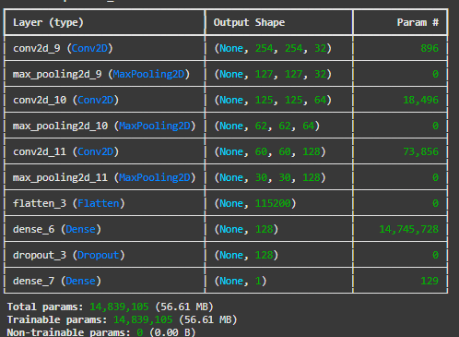
OUR MODEL
GRAPH
MODEL SUMMARY

Slide 11
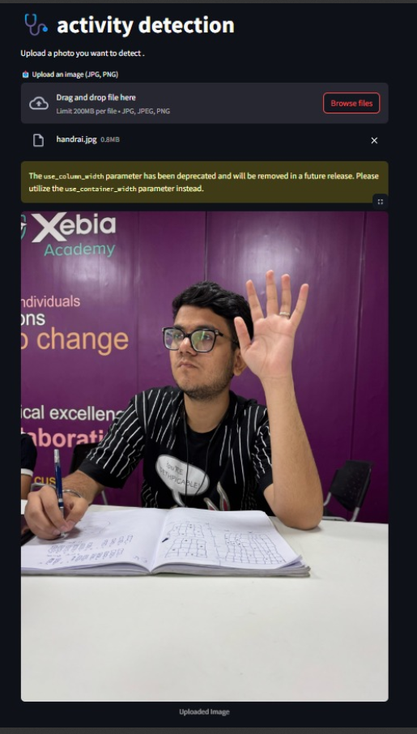
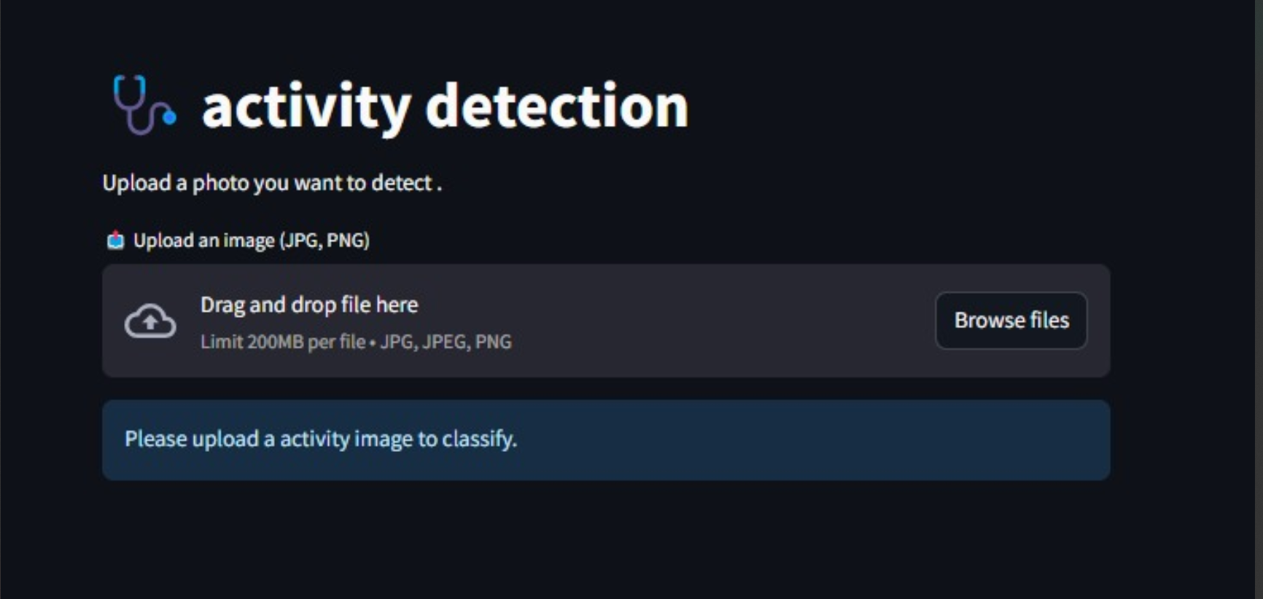

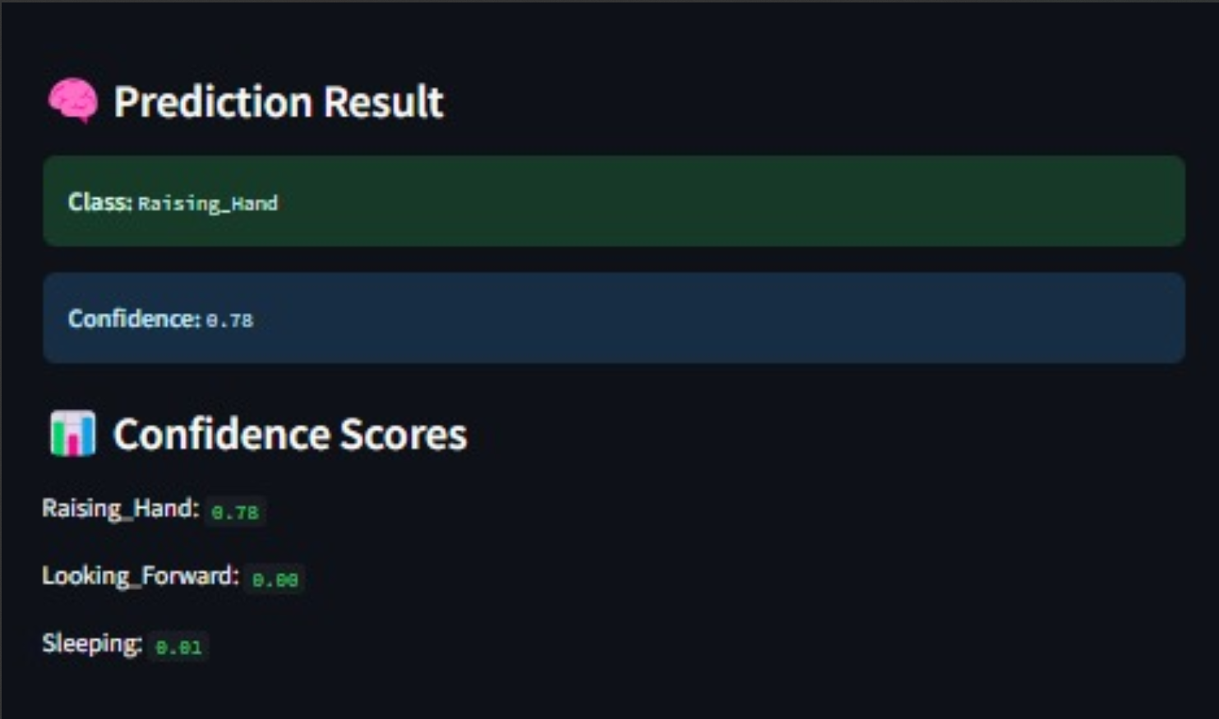
INTEGRATION WITH STREAMLIT APP

Slide 12
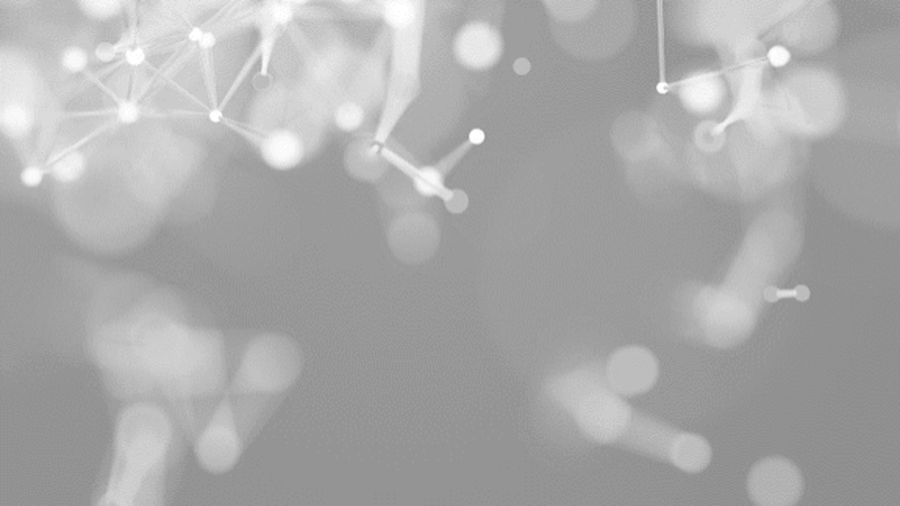
THANK YOU
DAKSH
YUG BENIWAL
YASH SHARMA

